Slide 1
Zehnder Ranch Elementary
Meeting with the Principal
March 21, 2017 6:30pm

Slide 2
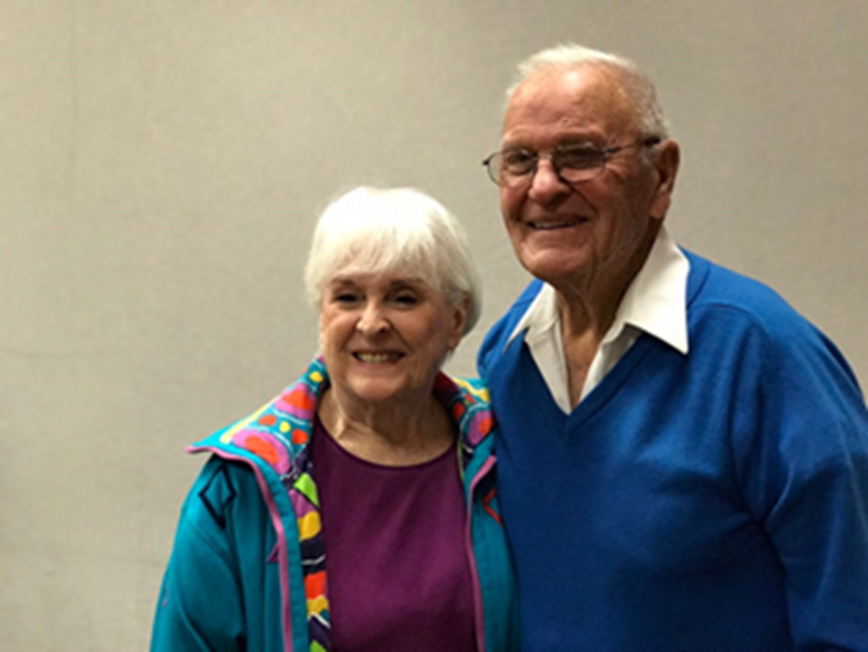
Zehnder family A Legacy of Leadership

Slide 3
A Legacy of Leadership!
Past President & Lifetime Member of Elk Grove Lions Club
Elk Grove Fire Department volunteer for 43 years
President of the Firemen’s Association
60 years of volunteering with Elk Grove High School operating the scoreboard
President of Elk Grove Softball Association
Cub Master for Boy Scouts of America
Coach for Pop Warner, Little League, soccer, and basketball
Member of the group that started the Western Festival Parade
Member of California’s Cattlemen’s Association
Board of Directors of First Security Bank of Elk Grove for 20 years
Member of the Cosumnes College Agricultural Board
Member of the Northern California Peace Officer Association
Elk Grove Citizen of the Year in 1969
Elk Grove High School Hall of Fame
Alfred Zehnder purchased property in 1939 for a dairy farm
The ranch was located on the land that is now COHS and even further east near the automall
Alfred then sold the land to his brother Louis Zehnder
Zehnder Ranch was converted from a dairy farm to a cattle operation
Mr. John Zehnder is one of the 3 children of Louis and Anne
John & Nancy Zehnder and their 7 sons operated the ranch
John and Nancy along with John’s siblings and their 7 sons all attended Elk Grove High School

Slide 4
ZEHNDER RANCH ELEMENTARY Mission Statement
We are the Longhorns!
Longhorns lead by
Pursuing Excellence in Teaching & Learning
Inspiring Clarity of Thinking
Advocating for Equity
Engaging Families
Encouraging Community Leadership
and through
Compassionate Support of Others

Slide 5
Core values
HUMANITY: All children feel safe, loved, and valued.
TEACHER LEADERSHIP: Teachers take on Leadership roles that play a role in decision making.
ACCOUNTABILITY: We take responsibility for student learning outcomes.
GOAL CONSENSUS THROUGH COLLABORATION: We align our practices and support one another.
RESPONSIVENESS OF LEADERSHIP: Our leaders take action to support student learning.
RESPECT FOR ALL PERSPECTIVES: Listen first, then listen more to foster understanding.
HIGH EXPECTATIONS: Establishing and maintaining a culture of high expectations is our guiding principle.

Slide 6
Zehnder ranch key design principles
PSP! Problem Solving Power
TK-12 Connection
Middle School Pathway for grades 4-6
On Grade Level Reading grades TK-3
Leadership & Advocacy
Special Ed/Gen Ed Alignment Professional Learning

Slide 7
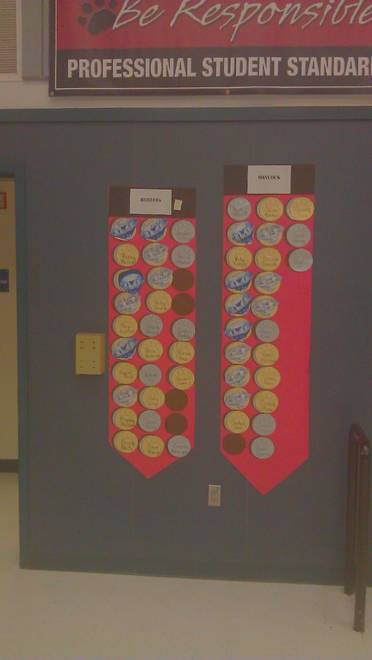
Horns Up! Let’s get to reading!!
Set yearly goals for grades 1-6
Post student achievement in the multipurpose room
Students earn BRONZE, SILVER, and GOLD Horseshoes for each level and DIAMOND when they meet the goal
All students recognized who meet their goals using classroom banners
Students meeting goals eligible for DIAMOND Field trip and DIAMOND movie day
Class rewards and individual rewards

Slide 8
Key to Ease of transition:
ZRES SCHOOL HANDBOOK
Supply List
Routines for morning, afternoon, and general guidelines
RIBBON CUTTING CEREMONY
Tomorrow morning 8:15 sharp
GRADE LEVEL ORIENTATION MEETINGS
First Grade TOMORROW @8:45 in classrooms
2nd-6th Grades

Slide 9
Zres handbook
Pick up one per family
Read it tonight!
You Will Be So Glad You Did!!

Slide 10
Ribbon cutting ceremony 8:15am Sharp! Read it once. Read it twice!
Find out your child’s teacher’s name out front
Walk your child to their teacher
Students get the best seats in the house ☺
Please leave your child with his/her teacher
Parents may take a seat on the cement seating or in the walk ways
Please leave the center seating open for students
Kinder and first grade parents---please also stand in the walkways
Kinder and first grade students will be walked out of the stage area by their teachers

Slide 11
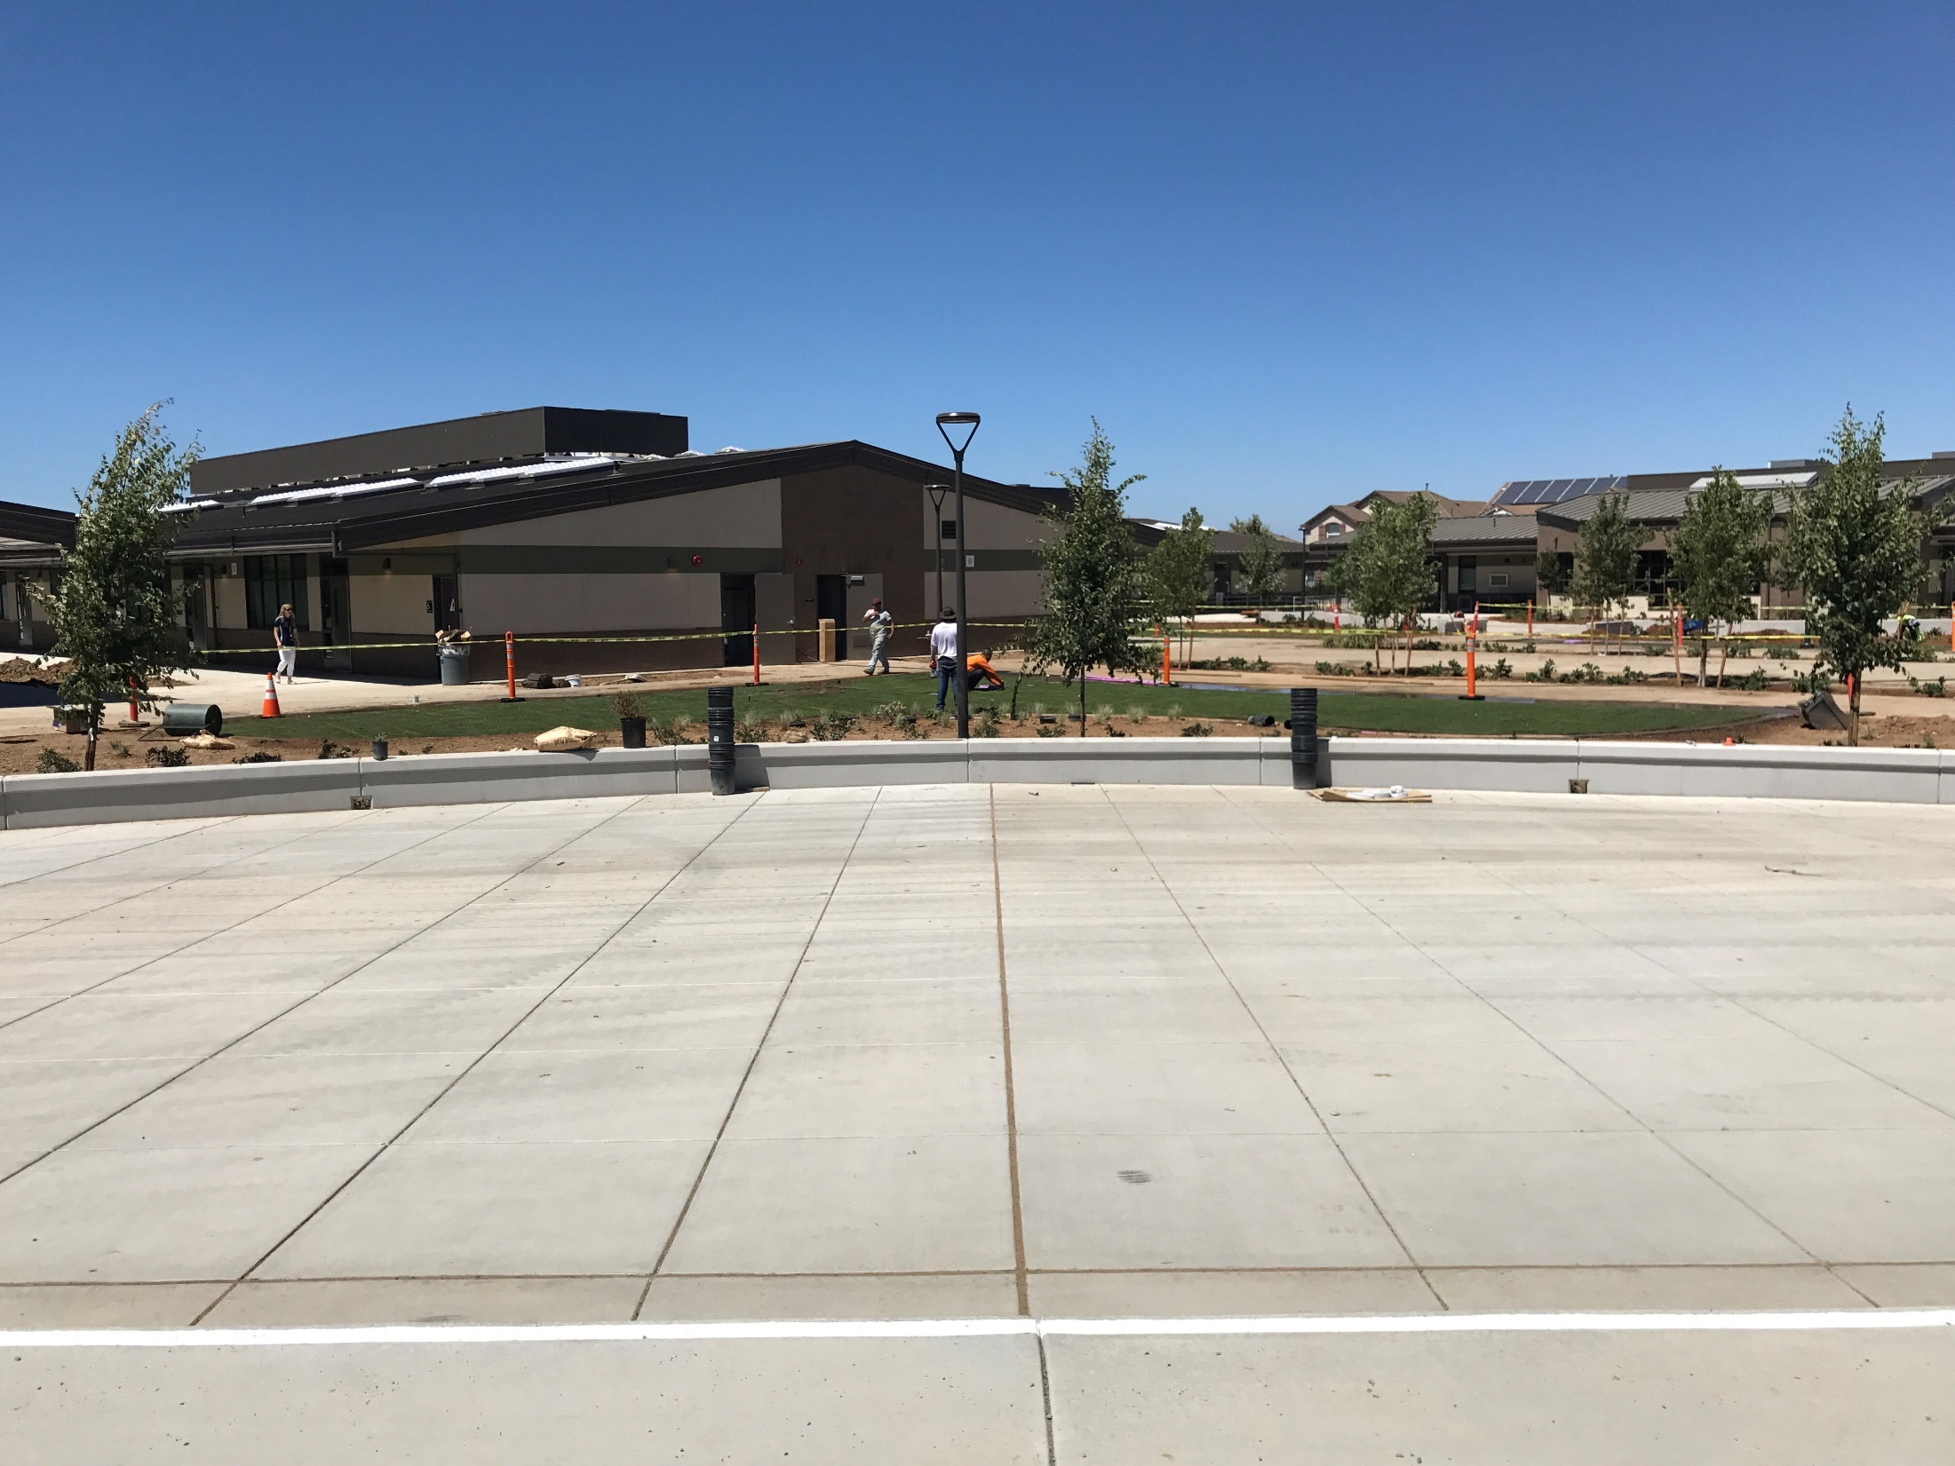
Longhorn adult area
Longhorn student seating
Teachers will have signs

Slide 12
Courtesy & communication
Equals a safe school!

Slide 13
Getting to school
DRIVERS
Driving in a car and waiting with your child in line:
You must park in the parking lot or in a valid parking are
Do not block our neighbors driveways
Driving in a car and dropping off in the valet area:
Pull all the way forward as far as you can
Students may exit car
Do not park in the valet area
Right turn only when exiting ZRES parking:

Slide 14
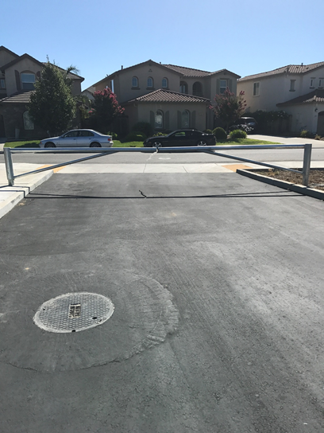
Gate at Elston is not an exit

Slide 15
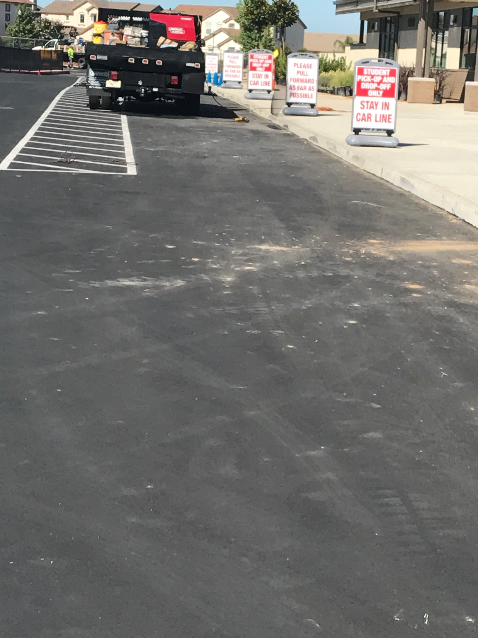
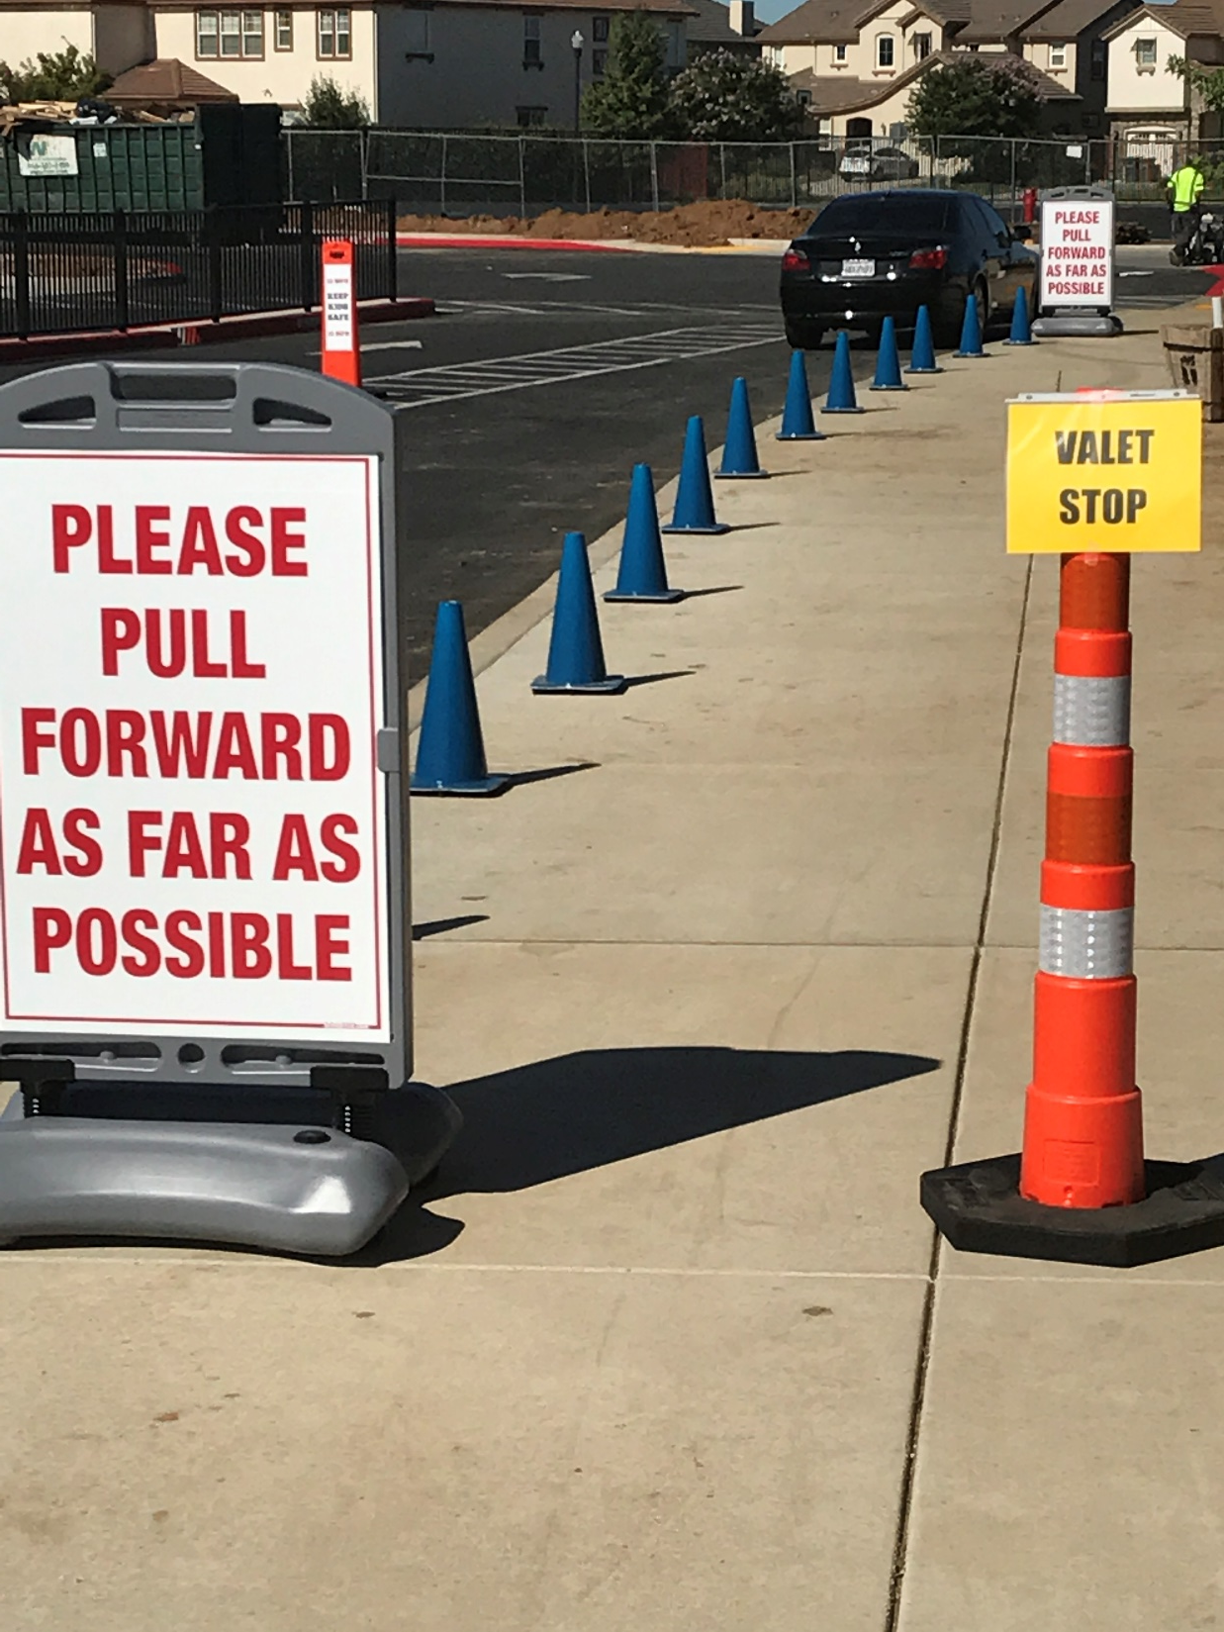

Slide 16
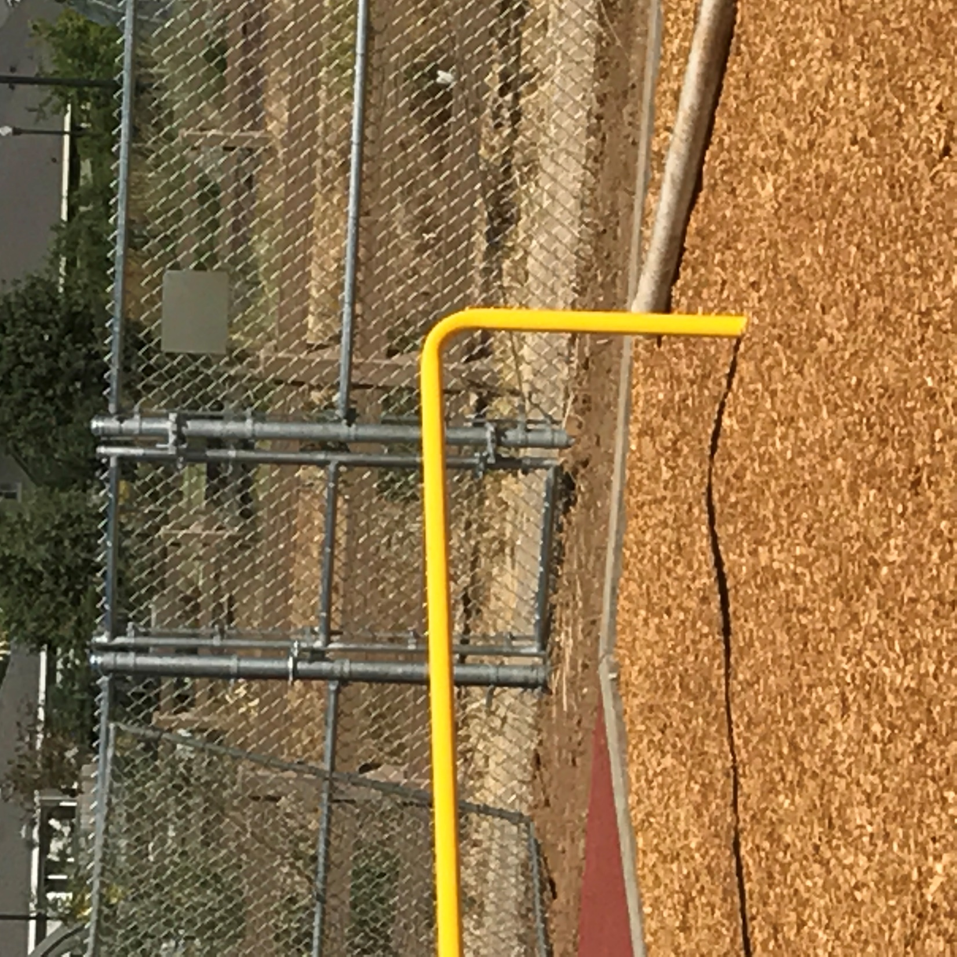
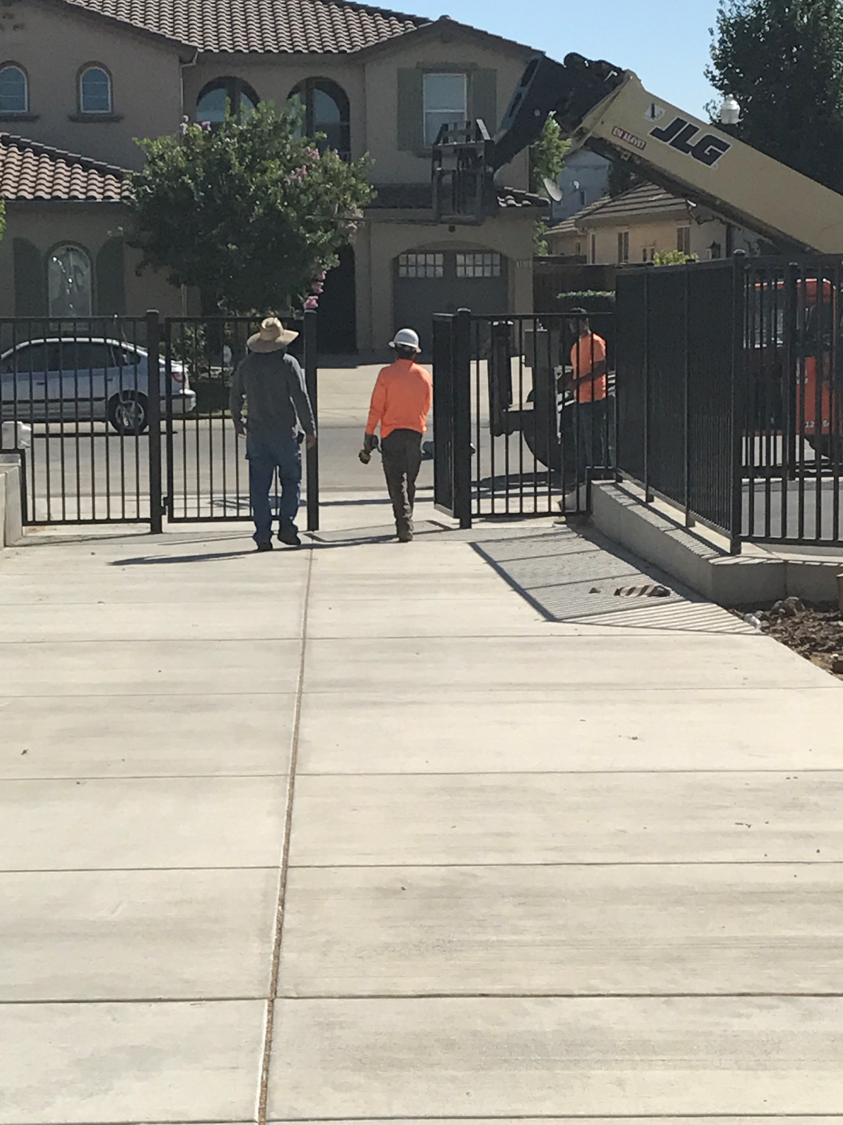
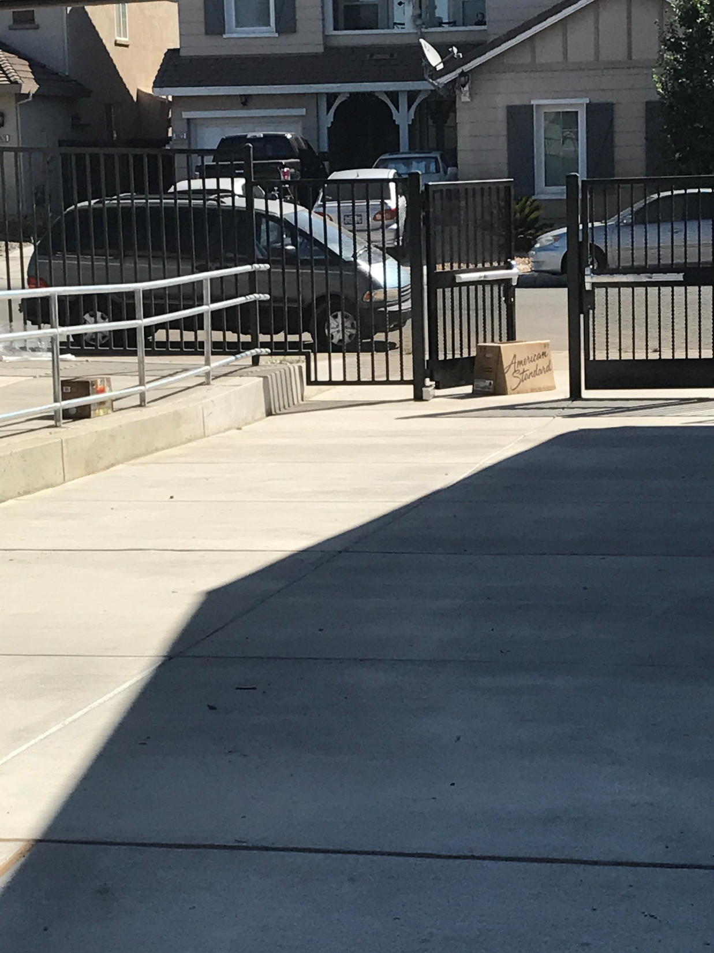
Getting to school zres…built to be a walking school
Back Gate from the Trail
Gate near the E Wing
Large gate to the right of the MP
Gate near the Kinder Wing

Slide 17
MAIN GATES SECURITY
GATE BETWEEN THE OFFICE AND THE MP UNLOCKED AND USED FOR STUDENTS USING VALET
LOCKED ALL DAY
Both Gates to the right and left of the office

Slide 18
Entry points
Yes!
Back gate near play structure
Kinder gate
E Wing gate
Large gate to the right of the MP
Entry 8:00-8:50
Parents parking may use the large gate next to MP to enter the campus
No Entry
Gate at Elston
Gate between the office and the bike rack
Gate between the office and the MP Room
3:15 Students using Valet use the VALET GATE

Slide 19
Start of the school day
Morning Kinder enter at kinder gate
Afternoon Kinder enter at kinder gate
Should you choose to use the office…you must sign in
Line up in area indicated by the kinder teachers
Grades 1-6
Primary in the stage area with dots
Intermediate in the stage area with dots

Slide 20
End of the day Teachers: 2 lines/walkers & valet
Walkers
Pick a Gate
Any Gate
AND THANK YOU FOR WALKING TO SCHOOL!
Valet: Students waiting in the pick up line out front
“Parkers”: Parents parking and picking up students
“Parkers” should pick up their student at the large gate to the right of the MP room and use the crosswalk to the parking lot
Horseshoe Park as a pick location is available, but will not have a staff member on duty

Slide 21
ENRICHMENT
Informational parent meeting
July 25 6:30-7:30
Band
gUITAR
Culinary
Choir
S.T.O.R.M.
ENGINEERING/ROBOTICS WITH LEGOS

Slide 22
FAMILY LEADERSHIP COUNCIL
“Re-Brand” of PTO
If your child goes to zres
You’re a member!
Nominations for officers will go out in two week

Slide 23
Family Leadership Council
Is there a cost for membership?
NOPE! ☺
Each family will be asked to provide a $20 student support donation

Slide 24
10 Spur family!
Students will receive their SPUR CARDS next Friday
Every time a family attends an FLC meeting---family earns a Spur
Every time a family helps coordinate or volunteers for 2+ hours for a school event---family earns a Spur
Provide a Student Support Donation to FLC---family earns a Spur
Special Invitation to those Families Earning 10+ Spurs…
Family Party at Wackford Center

Slide 25
First day of zres
Tomorrow
Ribbon cutting and honoring the Zehnder family

